Slide 1


Exploring Borrower Characteristics and Loan Performance:
A Lending Club Study

Slide 2


Dataset Introduction
Biases and Assumptions
Analysis
Recommendations
Final Thoughts
Q & A
Agenda

Slide 3

Dataset Introduction
Our dataset provides insight into Lending Club, a groundbreaking peer-to-peer lending firm headquartered in San Francisco, California.
Spanning from 2007 to around 2016, our dataset presents a comprehensive view of loans facilitated by Lending Club.
Lending Club offers a variety of loan products tailored to assist consumers with debt consolidation, weddings, and vacations.

Slide 4



Objectives and Goals
Can we identify correlations between borrower credit and financial profiles to reduce the rate of charged-off loans, while also leveraging historical borrower characteristics to customize loan products and enhance customer retention?
Goal # 1
Goal # 2
Goal # 3
Exploring Charged off Loans
Enhancing Customer Retention Rates
Tailored Loan Products for Borrowers

Slide 5


Uncovering Dataset Biases and Assumptions
Successful loans outnumber unsuccessful ones in the dataset.
The dataset covers loans issued from 2007 to 2016.
Annual income information has been grouped according to IRS 2024 income tax brackets, aiding in data retention and pinpointing areas for potential improvement
Debt-to-Income (DTI) ratios have been limited to 70 to remove outliers that could skew statistical analysis.
The dataset was obtained from Kaggle.

Slide 6
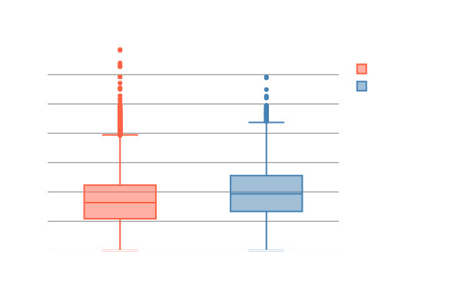

Loan Status vs Debt-to-Income Ratio (DTI)
Charged-off loans have higher median Debt-to-Income (DTI) ratios.
Statistical tests confirm the DTI differences are significant.
Further analysis shows a moderate impact, reinforcing that higher DTI is common in charged-off loans.

Slide 7
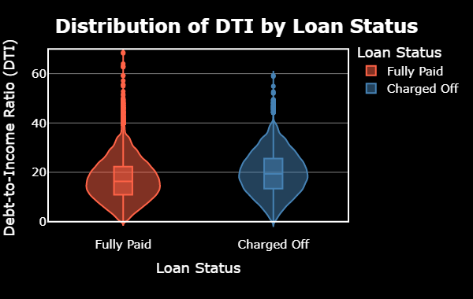
Loan Status vs Debt to income Ratio (DTI)

Slide 8

Loan Status vs Annual Income
Analysis of loan status and annual income.
Considerations: borrower errors, loan officer oversight, potential dead deals.
Data binned by 2024 income tax brackets.
Key Insight: As income rises, charge-offs decline.

Slide 9

Loan Status vs Annual Income

Slide 10
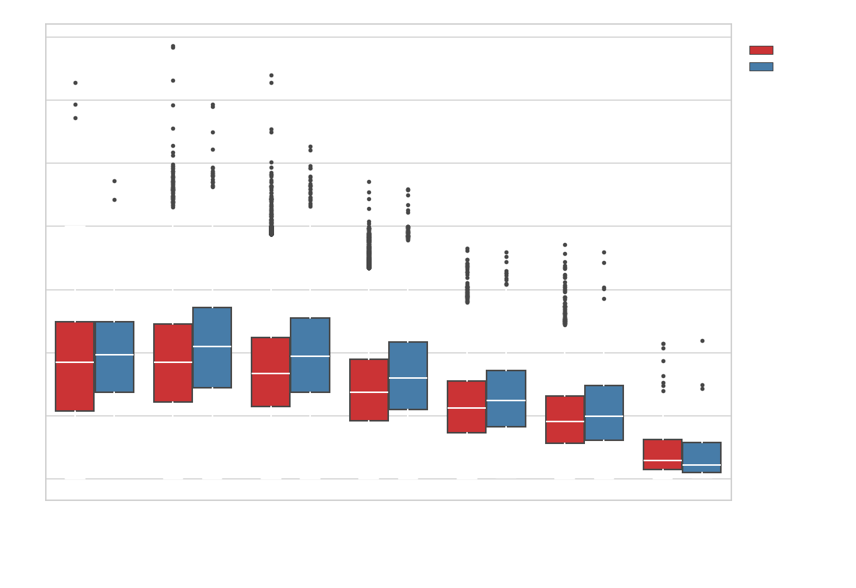
Loan Status vs DTI & Annual Income
Multivariate analysis checks income bins with DTI grouped by charged-off loans.
Higher DTI levels in charged-off loans across income bins.
Box plot shows charge-offs have higher interquartile distributions than fully paid loans.
Used DTI < 70 for consistency.

Slide 11
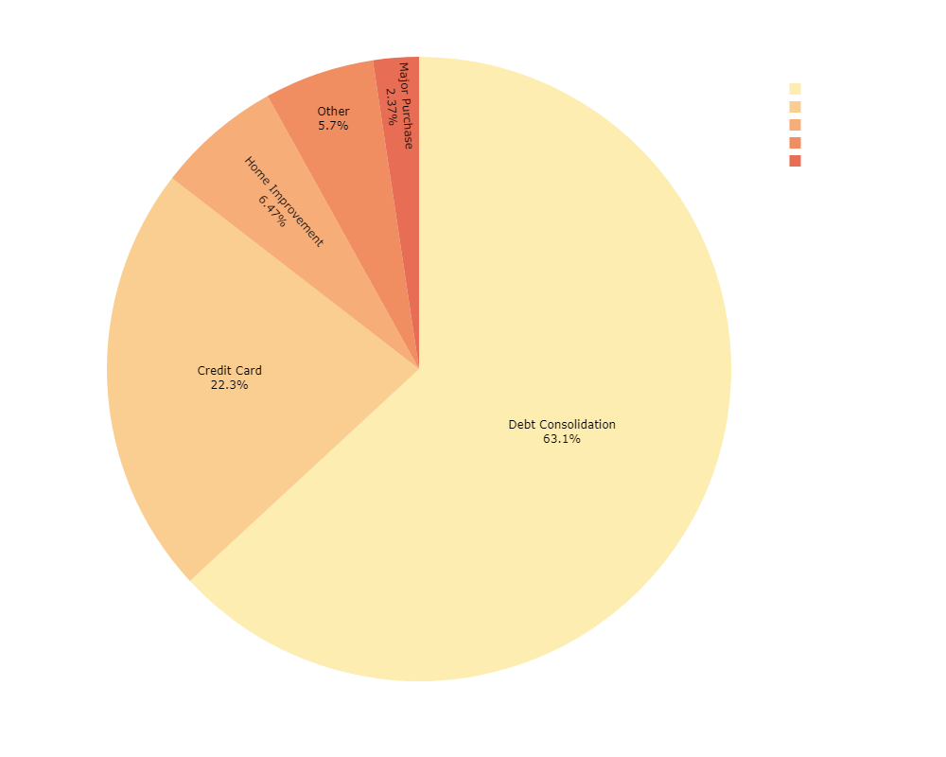
Loan Purpose Analysis
Debt consolidation is the primary reason for loans (63.1%).
Credit card repayment follows at 22.3%.
Other notable purposes: home improvement (6.7%), other (5.7%), and major purchases (2.3%).

Slide 12


Recommendations
# 1
# 2
# 3
Marketing Strategy for Debt Consolidation
Implement Dynamic Risk Models
Tightening Income Verification

Slide 13
Marketing Strategy for Debt Consolidation
Flexible Repayment
Structures
Graduated Interest
Rates

Slide 14


Implement Dynamic Risk Models
Benefits
Predict the probability of loan charge-offs
Proactive risk management

Slide 15


Tightening Income Verification
Improve
Data Integrity
Financial Literacy Programs

Slide 16






Final Thoughts
& Future Directions

Slide 17




Q & A

